Slide 1
BC Invasive Mussel Defence Program

Slide 2
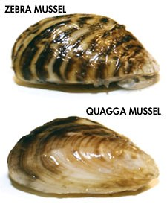
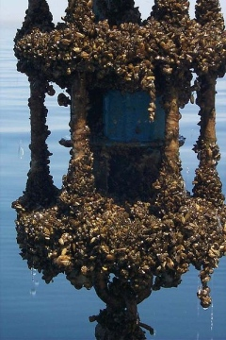
Zebra and quagga mussels
Zebra mussel (Dreissena polymorpha) and Quagga mussel (Dreissena rostriformis bugensis) are native to Europe.
First introduced into North America in the Great Lakes in the 1980’s by ship ballast water.
These freshwater mussels settle on any solid surface and grow in large clusters attached to each other.
They overgrow and clog water intake pipes of power stations, municipal water supplies and agricultural raw-water intakes
Notes:
Zebra and quagga mussels – freshwater species native to Europe (Black, Caspian, and Azov Seas)
Can only survive in very low levels of salinity but not in full marine environment

Slide 3
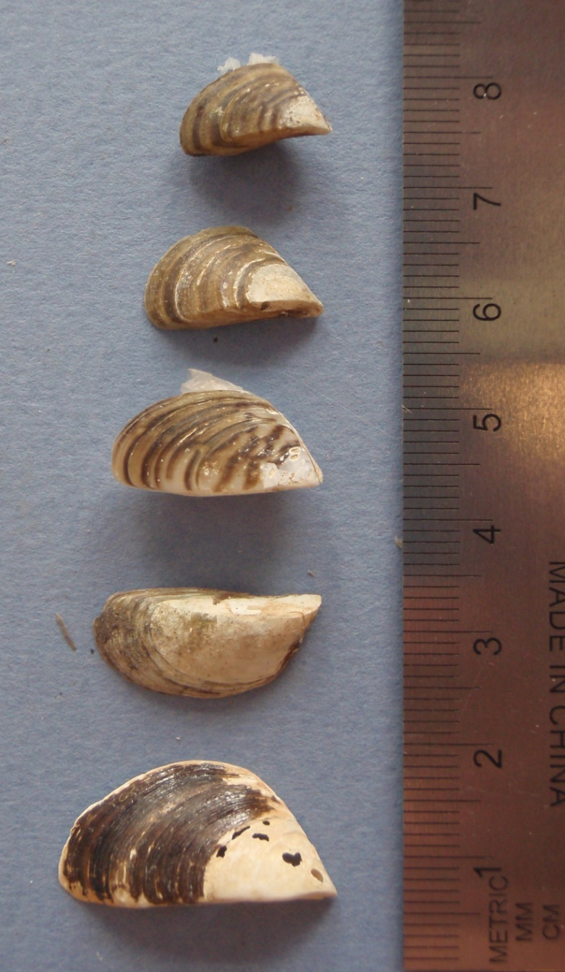
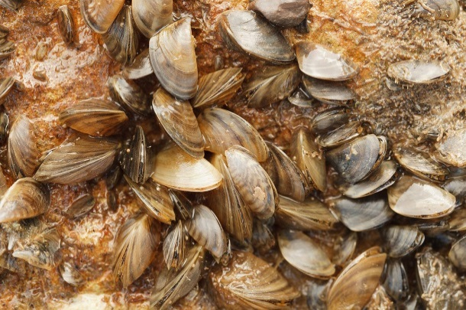
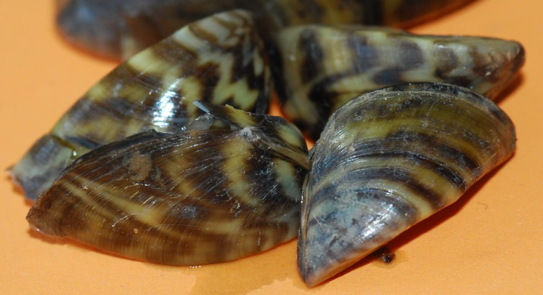
Zebra and Quagga Mussels
Small only up to 3cm / 1 inch
Form dense clumps attached to hard surfaces
Propeller blade shaped
Zebra stripes often but not always present
Tolerate high water flows <2m/s
Notes:
Very small in size only up to 1 inch as full grown adults and start attaching onto solid surfaces when they about the size of half a grain of rice which is how they can go easily undetected attached to boats
Color and pattern can vary and stripping is not always prominent, size is the best way to identify from native mussels
They can tolerate very high water flows which allows them to clog water intake pipes and damage infrastructure of hydropower facilities

Slide 4
Native freshwater mussels vs. invasive mussels
Invasive Mussels
Native Mussels
Notes:
Size is the best way to distinguish invasive zebra and quagga mussels from our native species. Color and patterns can vary and concentric rings on native species can be mistaken for zebra pattern so size is key.
No native freshwater mussels in NA have bissal threads and the ability to attach onto solid surfaces so native mussels will not be found attached onto any solid surfaces such as docks, pilings, and will only be found in the substrate.

Slide 5
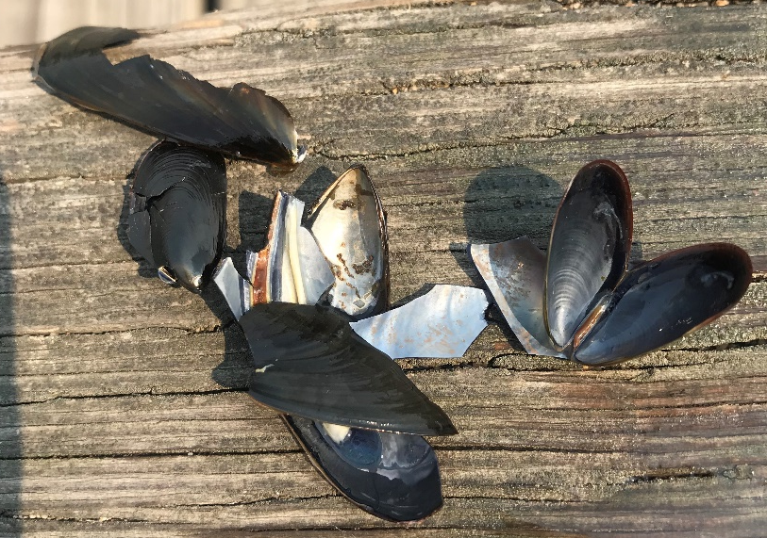
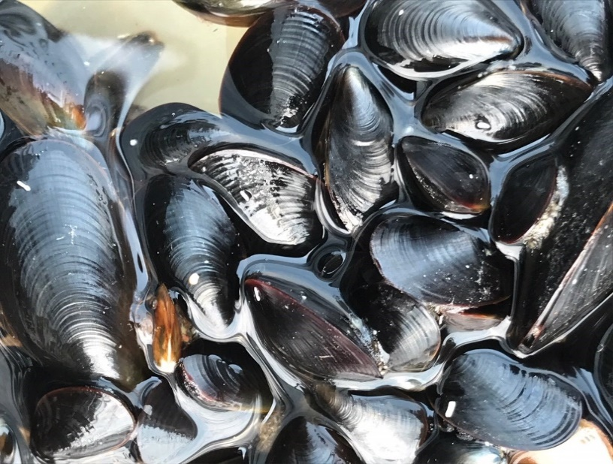
Marine mussels
Outside shell is glossy bluish or bluish black, sometimes pale brown
Inside is generally violet in color
Pear-shaped and ventrally flattened shell
Typically full size is 5-10cm, but can range from 2cm to 20cm
Presence of byssal threads

Slide 6
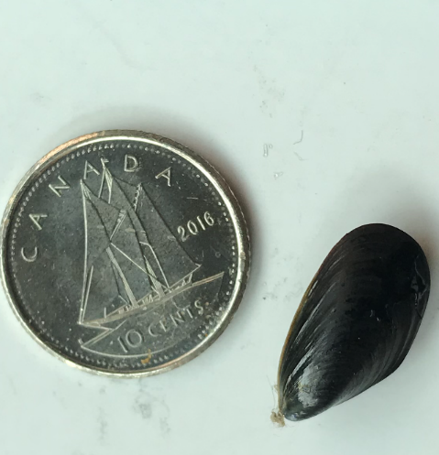
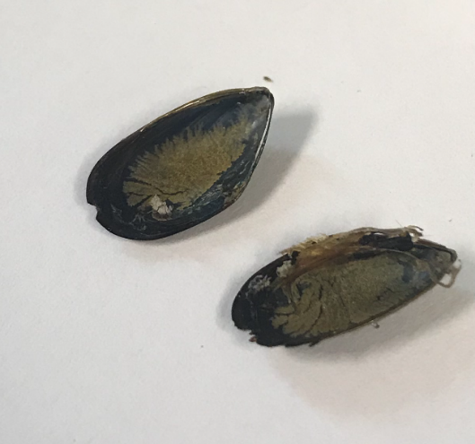
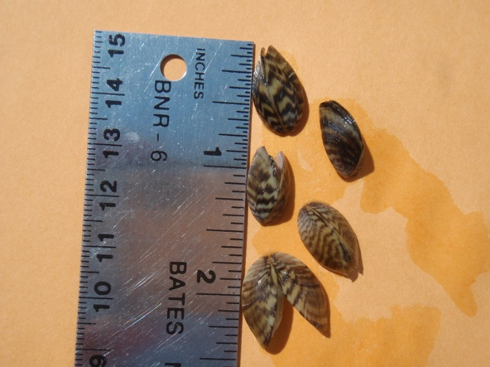
Marine mussels Invasive mussels

Slide 7
Ecological Impacts
Single mussel can filter 1L water/day - removing nutrients from water column
Outcompeting with native species of mussels and fish for food
Single female can release 1M eggs per spawning season
Rapid reproduction, invasive mussels overtake the environment and reduce habitat for native species

Slide 8
Economic Impacts in BC
Sector | Annual costs | % total impact
Hydropower generation | $6,524,532 | 15.2
Agriculture - Irrigation | $14,800,000 | 34.4
Municipal water supplies | $9,251,608 | 21.5
Recreational boating | $12,385,962 | 28.8
Fisheries, Tourism, Property values | ?????
Total | $42,962,102
Notes:
Impact assessment for BC estimates $43M annual if zebra or quagga mussels were to be introduced to BC.
This does not include impacts to Fisheries (commercial and recreational), tourism, and property values

Slide 9
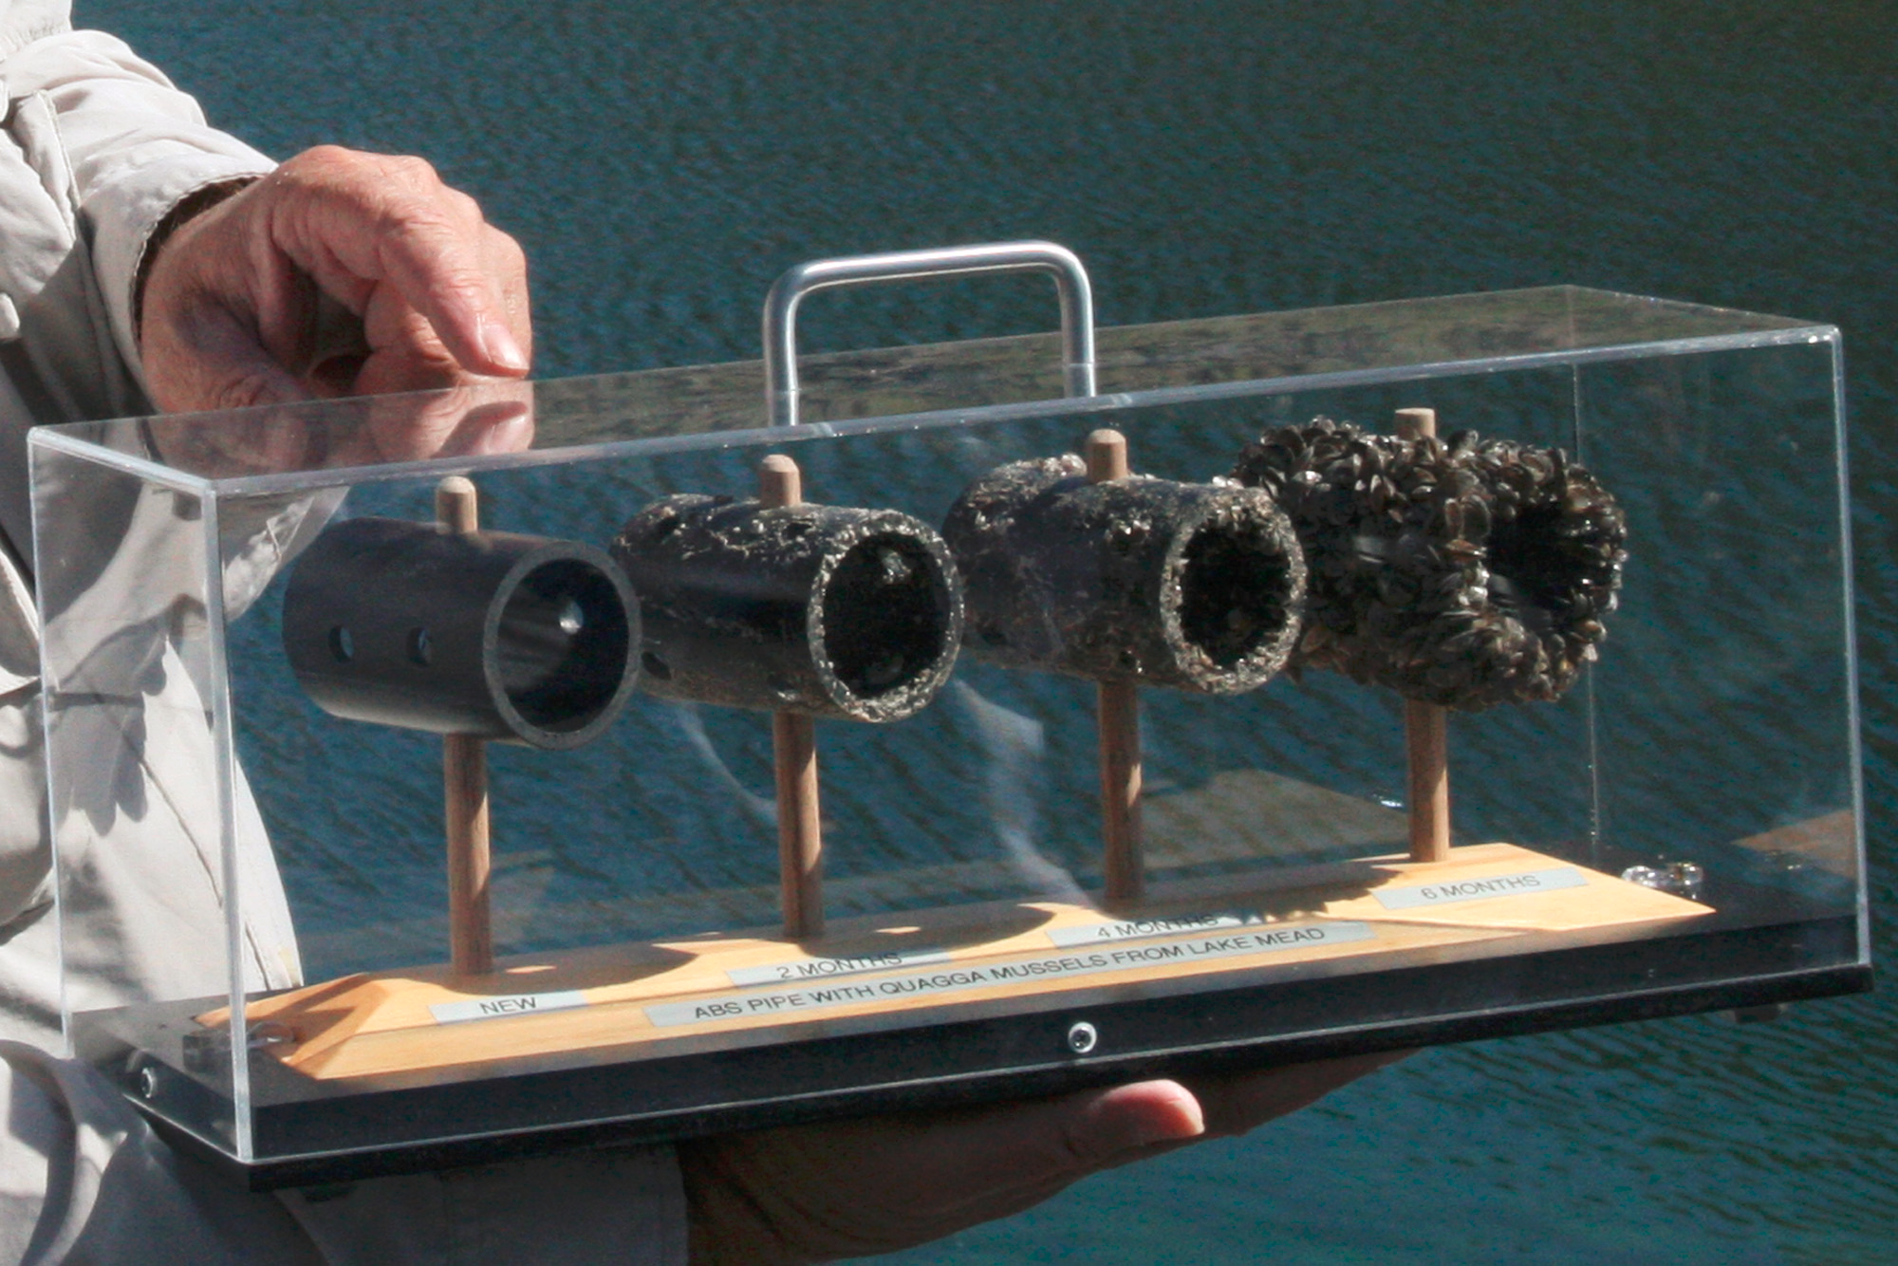
Notes:
Shows how quickly a pipe is overtaken by quagga mussels over a six month period in Lake Mead

Slide 10
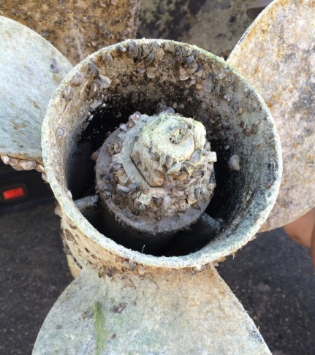
Vectors
Overland movement of boats and water equipment
Notes:
The primary vector – source for spread of ZQM in NA is hitchhiking onto boats and overland movement of boats from infested lakes to non-infested lakes. The ability of ZQM to survive out of water for 30 days and their very small size allows them to go easily undetected at hitchhikers on watercraft being transported overland.

Slide 11
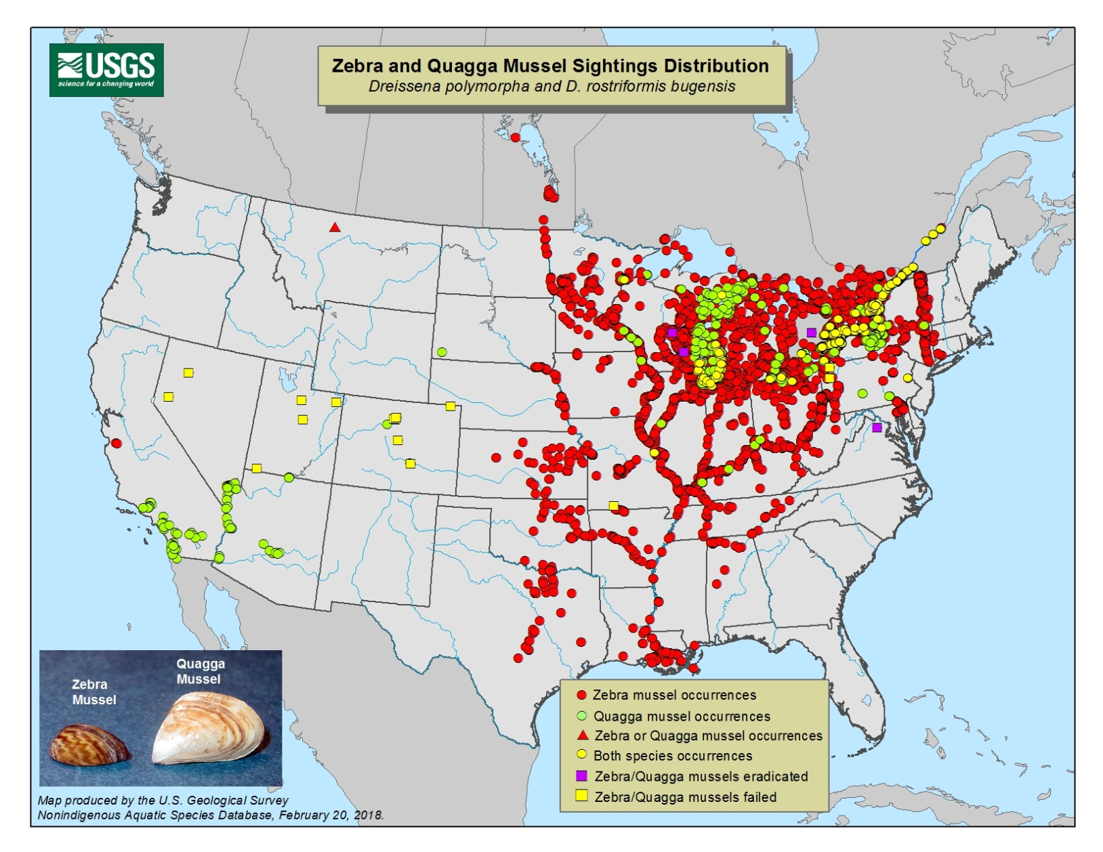
Distribution
Notes:
Since their first introduction into the great lakes in the late 1980’s they have spread widely in NA and this shows the current distribution of ZQM, and the detection in Montana in 2016 is the furthest west and closest detection to BC.
BC is one of several jurisdictions in the Pacific Northwest that does not yet have ZQM and BC launched the Invasive Mussel Defence program to prevent the introduction of these freshwater invasive mussels

Slide 12
Invasive Mussel Defence Program
Watercraft Inspection Stations
Launched in 2015, program has grown to 64 inspectors
Program operations now delivered by Conservation Officer Service
Early Detection Lake Monitoring
Sampling for presence of invasive mussels since 2011
All samples negative to date, efforts increasing for 2018
Outreach & Education
Clean, Drain , Dry messaging for invasive mussels and other AIS
Over 130,000 outreach interactions at inspection stations
Notes:
The invasive mussel defence program was first piloted in 2015 with 6 auxiliary conservation officers and has grown to 64 auxiliary conservation officers.
The three main areas of the program are the Watercraft Inspection stations, early detection lake monitoring and outreach and education and across all these areas of the program partnerships and collaboration has been a foundation to the program

Slide 13
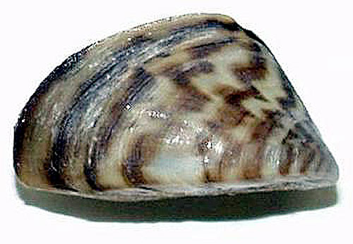
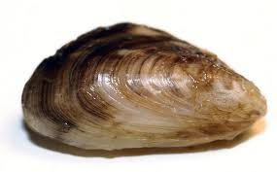
Regulatory Tools
Controlled Alien Species Regulation BC Wildlife Act
Schedule 4 Prohibited Species (Alive or Dead):
Prohibited to possess, breed, transport or release
Family Dreissenidae
Zebra Mussel Quagga Mussel
Notes:
It is under the Controlled Alien Species Regulation of the BC wildlife act that prohibits anyone to possess, breed, transport or release zebra or quagga mussels dead or alive in BC
All provincial AIS inspectors are appointed as auxiliary conservation officers with specific powers under the CAS to inspect and decontaminate watercraft and issue decontamination orders and quarantine periods

Slide 14
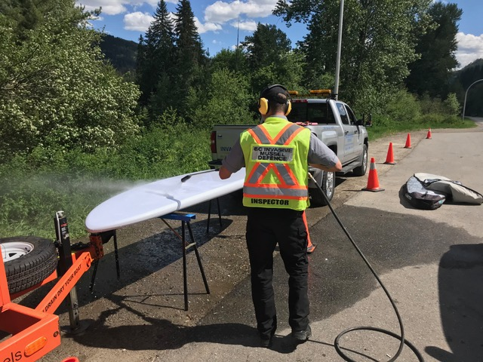
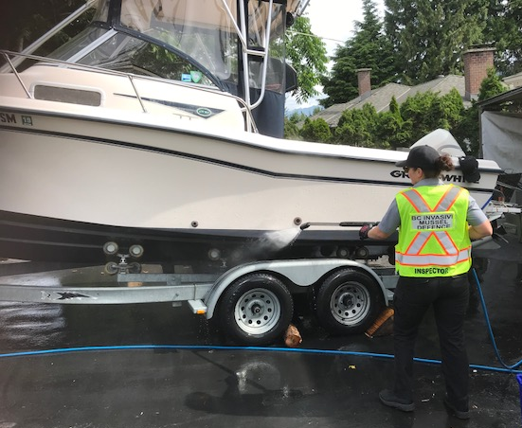
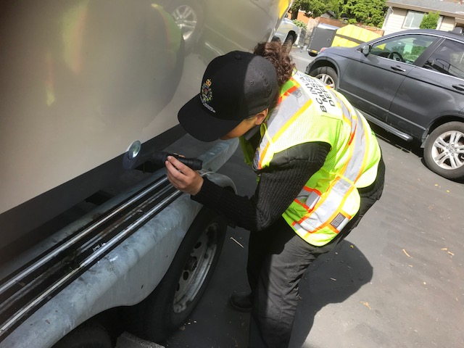
Watercraft Inspection and Decontamination
Notes:
All provincial inspectors are trained on watercraft inspection and decontamination to the standards used across the western provinces and states.
Every inspection station is equipped with a mobile decontamination unit which uses hot water (60) to kill the mussels and high presssure to remove the mussels. No chemicals are used during the decontamination process
Decontamination is free

Slide 15
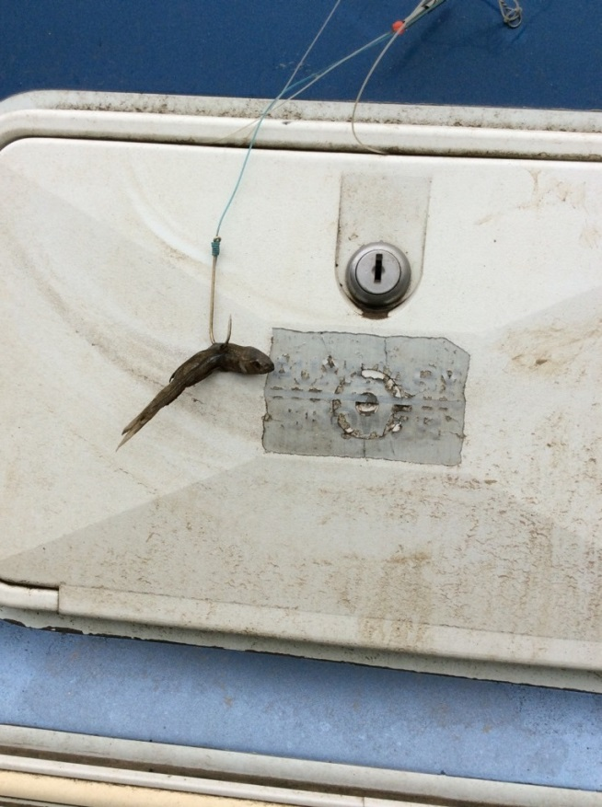
Not Just Mussels
Notes:
While the primary focus at the watercraft inspection stations is to check for invasive zebra and quagga mussels. Inspectors are also looking for other aquatic invasive species to prevent the introduction of other AIS and prevent the spread of AIS that are present in some parts of the province such as Eurasian watermilfoil

Slide 16
Program Funders
Notes:
Since the program was piloted in 2015 it has grown and expanded substantially from 6 auxiliary inspectors to 64 and this expansion was possible through partnership with four hydropower companies in BC, with multi-year partnerships that started in 2016

Slide 17
Watercraft Inspection Data
 | 2015 | 2016 | 2017
Total Watercraft inspected | 4,350 | ~24,500 | 35,500
Number of people interacted with | ~10,000 | ~50,000 | 72,300
High Risk Inspections | 70 | 685 | 2,071
Mussel fouled boats | 15 | 17 | 25*
* BC received advanced notification for 20 of the mussel fouled boats in 2017
Notes:
With the expansion of the program the total number of watercraft inspections has increased substantially over the years
We have not since a proportional increase in the number of mussel fouled boats which is encouraging and in 2017, the program received advanced notification for 20 of the 25 mussel fouled boats. This means the boat went through an inspection station in another jurisdiction and BC was notified in advance so inspection and if necessary decontamination could be performed
It may not always be possible to decontaminate a watercraft at a roadside inspection station for a number of reason:
Large commercially hauled boats cannot be fully inspected (shrink-wrapped, keys at destination, on large trailer)
Engine is out of gas/battery dead prevents engine flush from being done
All crews have mobile decontamination units so inspection and decontamination can be arranged at a safe location/destination

Slide 18
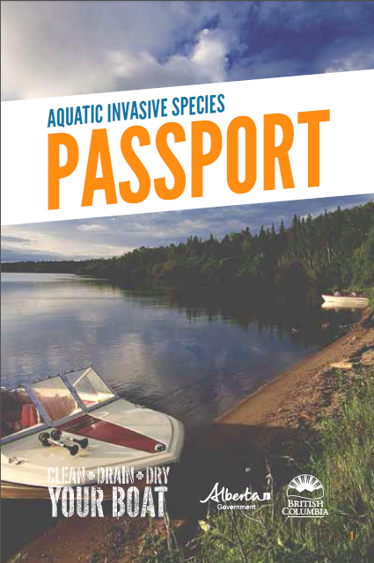
BC & AB Passport Program
Passports issued at Inspection stations to:
Boaters frequently traveling between BC & AB;
Boaters frequently traveling within BC
The date & location of inspections is recorded in the passport
Still mandatory to stop at all inspection stations
Speeds up the inspection process for passport holders
Boaters must sign commitment form to practice Clean, Drain, Dry

Slide 19
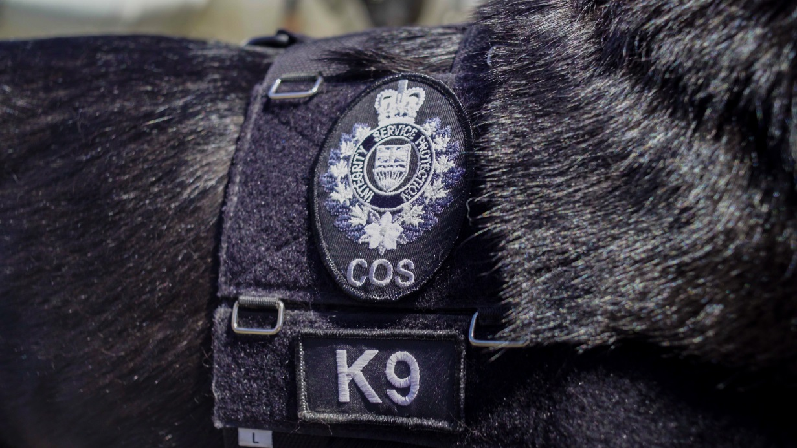
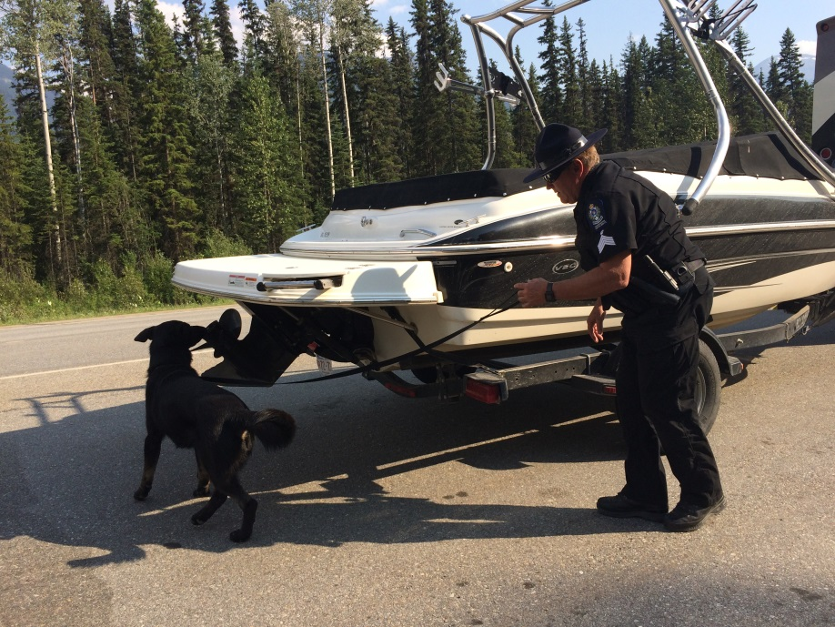
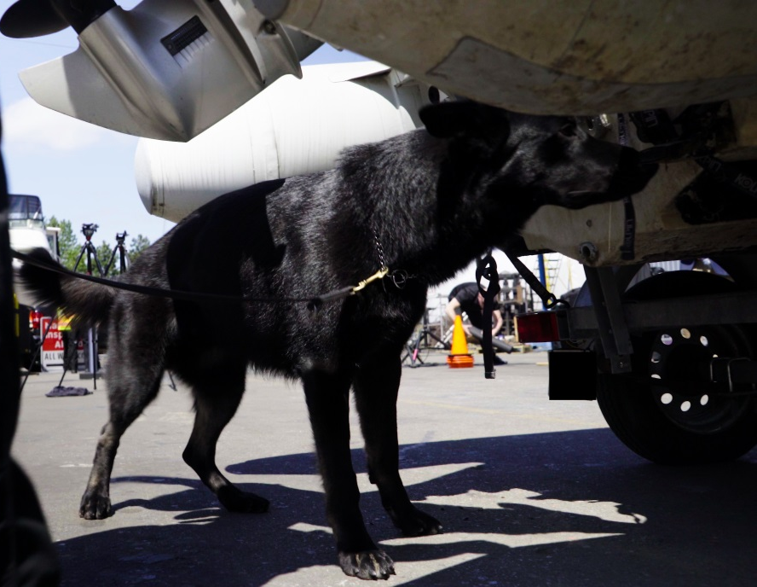
Notes:
New in 2017 was the addition of the AIS K9 unit and Kilo is a german shepard trained in invasive mussel detection and in several areas of enforcement including evidence recovery, firearms, human scent detection, and illegal trade of bear parts.
Kilo and his Sergeant handler will be touring the inspection station again in 2018

Slide 20
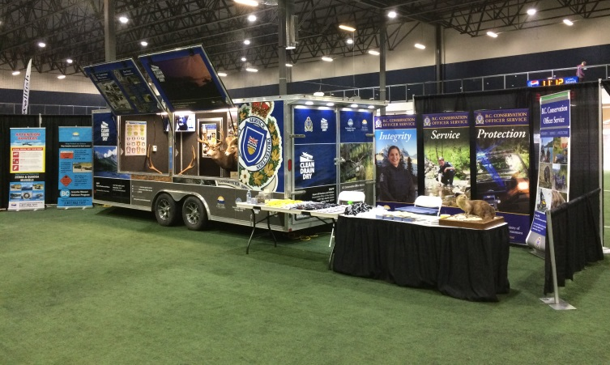
Outreach & Education
Central component of program outreach & education through:
Promoting Clean, Drain, Dry message
Outreach campaigns targeting boating industry (marinas, commercial haulers)
Attendance at boating/outdoor shows and events
Working with international boating events to inspect and when necessary decontaminate boats
Notes:
Outreach & education is another major component of the program to promote the key message of clean, drain, dry to boaters and anglers
In addition to outreach at the inspection stations, program staff also attend boating/angling shows and events

Slide 21
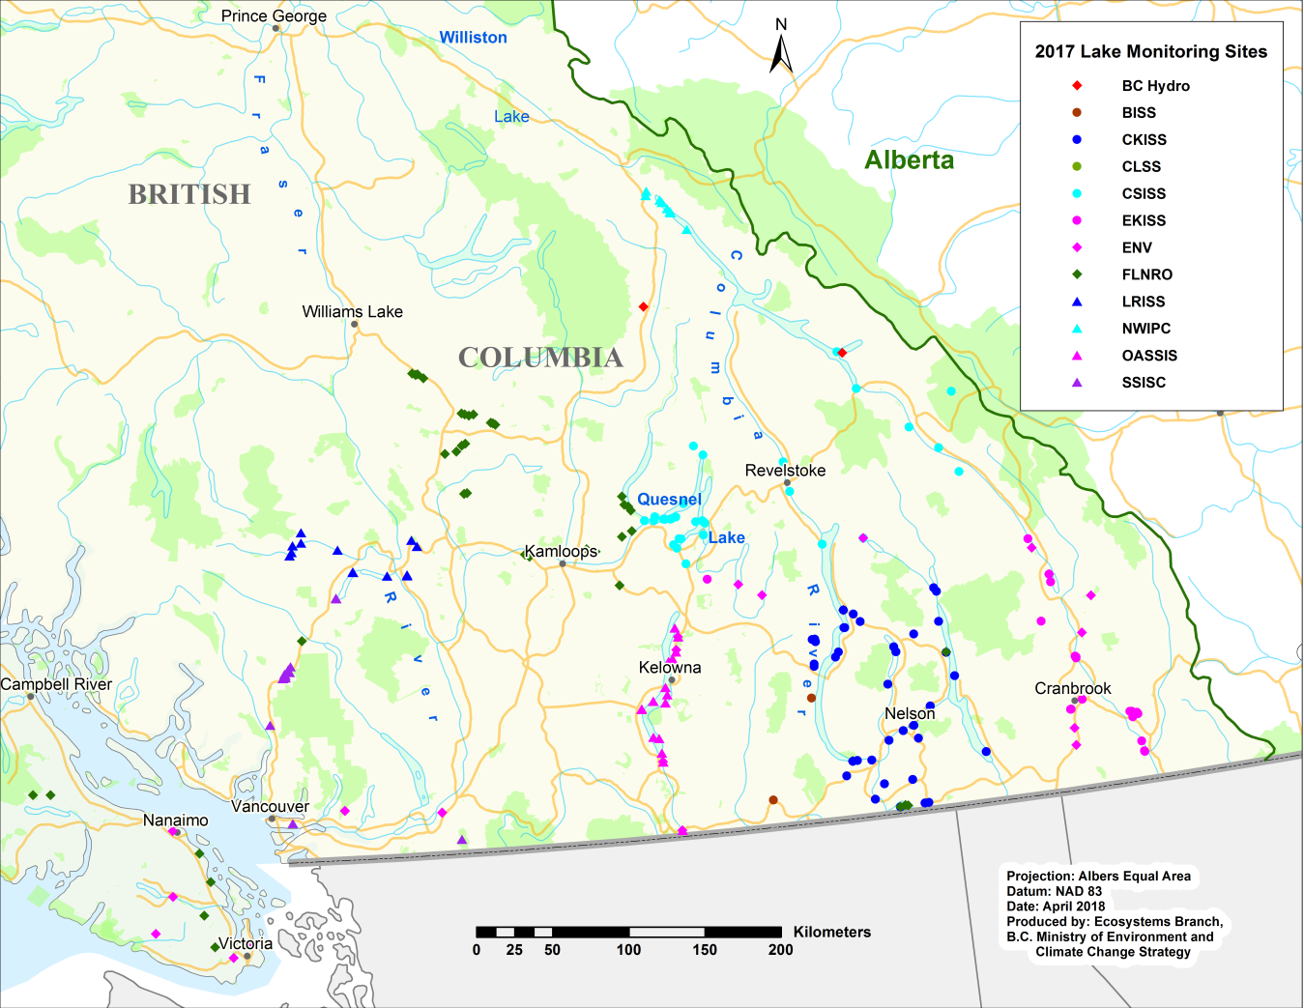
Lake Monitoring
Plankton tow samples analyzed for ZQM veliger detection
Monitoring since 2011
In 2017, 400 samples collected from just over 100 lakes –all negative for ZQM veligers
Samples collected by partnering groups and Ministry staff.
Notes:
The other area of the program is the early detection monitoring for the presence of invasive mussels. Water samples are collected and tested for the presence of invasive mussel larvae and this has been taking place in BC since 2011 with monitoring efforts increasing each year.
In 2017 400 samples were collected from just over 100 lakes and tested for invasive mussels and all samples came back negative

Slide 22
2018 Season
 | 2015 | 2016 | 2017 | 2018
Inspection Stations | Roving | 8 | 10 | 12
Number of Auxiliary Conservation Officers | 12 | 32 | 65 | 64*
Hours of Operation | 5 days/week & 7hrs/day | 7 days/week & 10hrs/day | 9 stations dawn-dusk 7 days/week, 1 station 24hrs | 1 station 24hrs, 5 dawn to dusk, 6 10hrs/day
Inspection Season | June-October | April to Sept/Oct | April/June to mid November | April to end of Sep and Oct
*Plus two dedicated Sgt’s in COS touring inspection stations
Notes:
For the 2018 season there are 64 auxiliary inspectors across 12 inspection stations and the Golden inspection station will remain 24hrs for the peak boating season. Inspection stations will be open until late October

Slide 23
2018 Inspection Stations
Notes:
Inspection stations are located at key entry points along the eastern and southern borders targeting boaters coming from outside of BC. The program works very closely with CBSA to receive notification of watercraft coming through the southern Ports. In 2017 the program received just over 300 notifications from CBSA
The two new inspection station locations is a result of adjustment to locations in the East Kootenays. Through strong collaboration and support with TRAN new site were identified on Hwy 93 targeting boats coming from Montana and a new site between Fernie and Sparwood targeting traffic on Hwy 3 from the east

Slide 24
New Watercraft Inspection Signs
Notes:
Partnership with TRAN on development of new watercraft inspection station signs, extensive efforts were put in by Minsitry of Transportation and infrastructure staff to come up with the great new designs
New designs aimed to increase awareness and visibility at inspection stations, additional icons to help increase awareness that it is mandatory for all watercraft to stop (motorized and non-motorized)
Signs also include the fine for failing to stop at the inspection station to help increase compliance

Slide 25
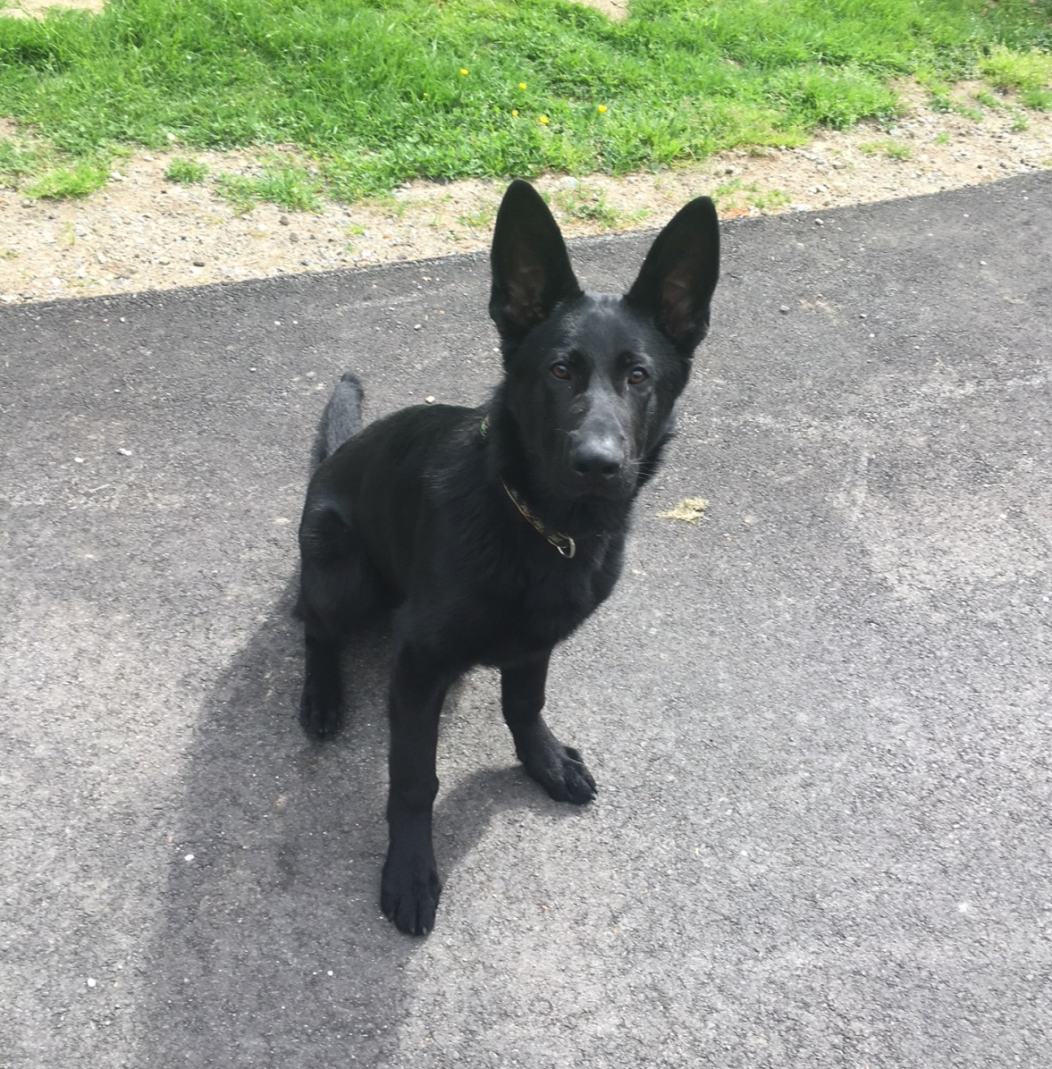
Expansion of the K9 Unit
K9 Major will be joining Kilo in the 2019 season once he has completed his training
Notes:
Another big announcement this year is the expansion of the program’s K9 unit with the addition of Major who is six months old and will be joining Kilo in the 2019 season once he has completed his training

Slide 26
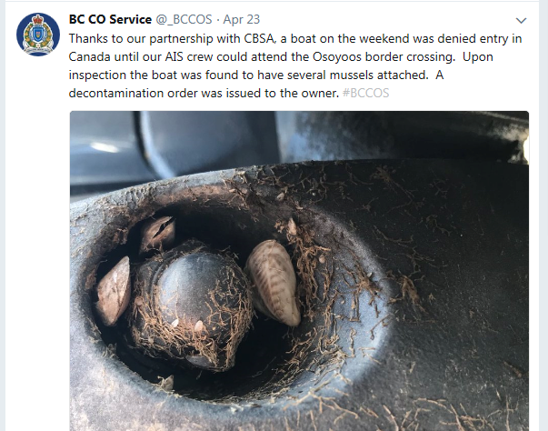
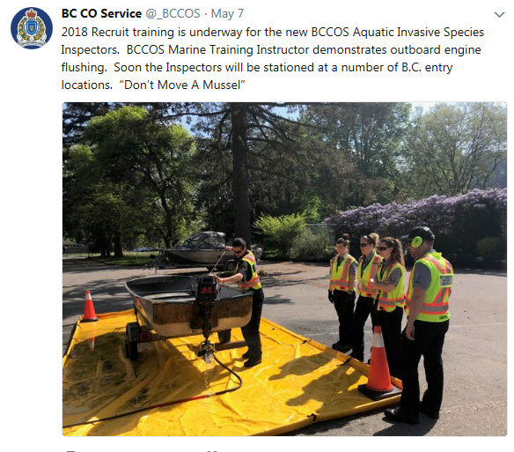
Updated Website
Updates to program website gov.bc.ca/invasivemussels
Links to Program reports, EDRR plan, Lake Monitoring Field protocol
Information about 2018 watercraft inspection stations and links to Conservation Officer Service social media
Notes:
A number of updates have been made to the program website includes links to all the program’s past reports, information about the 2018 season and inspection stations, information about the BC/AB passport program, and the lake monitoring protocol
Another big update to the website is clearer information about reporting invasive mussels and how to contact the program if you are bringing your boat to BC

Slide 27
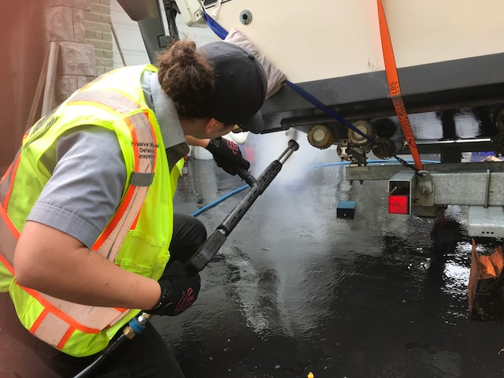
2018 Watercraft Inspections (as of Aug 17th)
~33,000 inspections
65,000 interactions to promote CDD/AIS awarness
1,412 high risk inspections
374 decontaminations performed
20 mussel fouled boats
Advanced notification for 15
Notes:
273 Decontamination Orders were issued, and 203 watercraft were issued quarantine periods to meet the required 30-day drying time.
The Program received advanced notification on 15 of the 20 mussel fouled boats either from another jurisdiction (e.g., AB, MT, ID, WA) or by Canada Border Services Agents (CBSA).
Between May 15 and August 17, 355 watercraft were inspected at night (10 p.m. to 5 a.m.) at the Golden inspection station on Hwy 1. Of those, 19 were identified as high risk and two of the mussel fouled watercraft have been intercepted between 10 p.m. and 5 a.m.
79 tickets and 44 warnings have been issued by Conservation Officers to motorists for failing to stop at inspection stations.

Slide 28
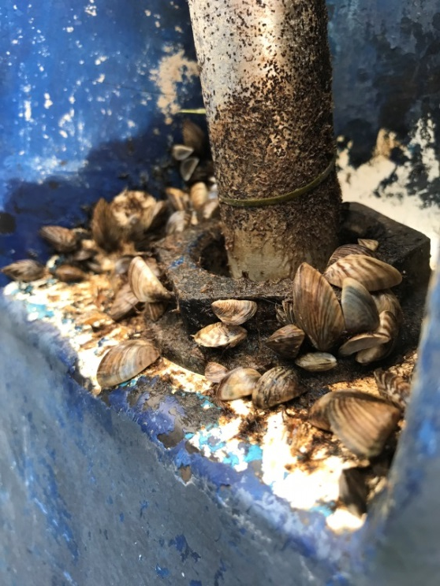
2018 Mussel Fouled Watercraft
Notes:
Ontario (10), Arizona (4), Manitoba (2), Michigan (2), Utah (2) and Nevada (1)

Slide 29
2018 Mussel Fouled Watercraft
DESTINATION LOCATION
Notes:
the Lower Mainland (8), Okanagan (3), Thompson-Nicola (4), Vancouver Island (4), and the Kootenays (1).

Slide 30
Bringing Your Boat to BC
If you are bringing your boat from outside BC contact the Program at COS.Aquatic.Invasive.Species@gov.bc.ca
Key information we need:
Where the boat is coming from and when was it last in the water
Destination location
Contact information (either owner, hauler/driver or destination location)
Type of boat
Notes:
If you are bringing your boat from outside BC, contact the program through our email inbox which is monitoring by all the provincial inspectors and program staff and the Program will contact the boater to determine if inspection and potential decontamination is required based on the risk.

Slide 31
Remember to always practice Clean, Drain, Dry
CLEAN: off all plants, animals and mud from your boat and equipment (e.g. boots, waders, fishing gear)
DRAIN: onto land all water from bait buckets, livewells, pumps, motor, bilges, and remove drain plugs
DRY: all items completely before launching the watercraft into another body of water.
Notes:
Not just for ZQM but for other AIS and to prevent the spread of species that are currently in some parts of BC and not others, also not just clean drain dry your boat but your gear as well, because AIS can be found in mud attached to gear and equipment

Slide 32
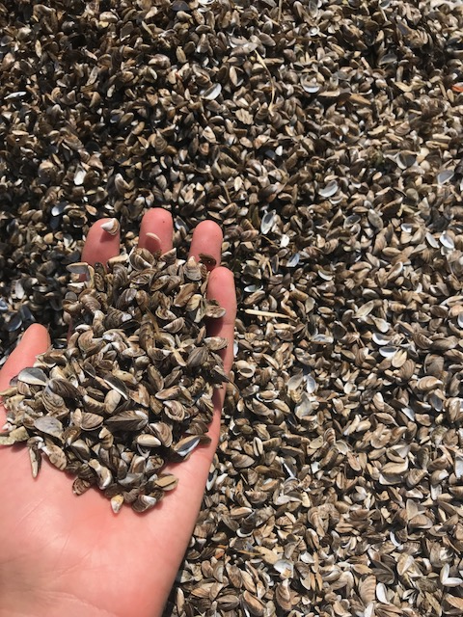
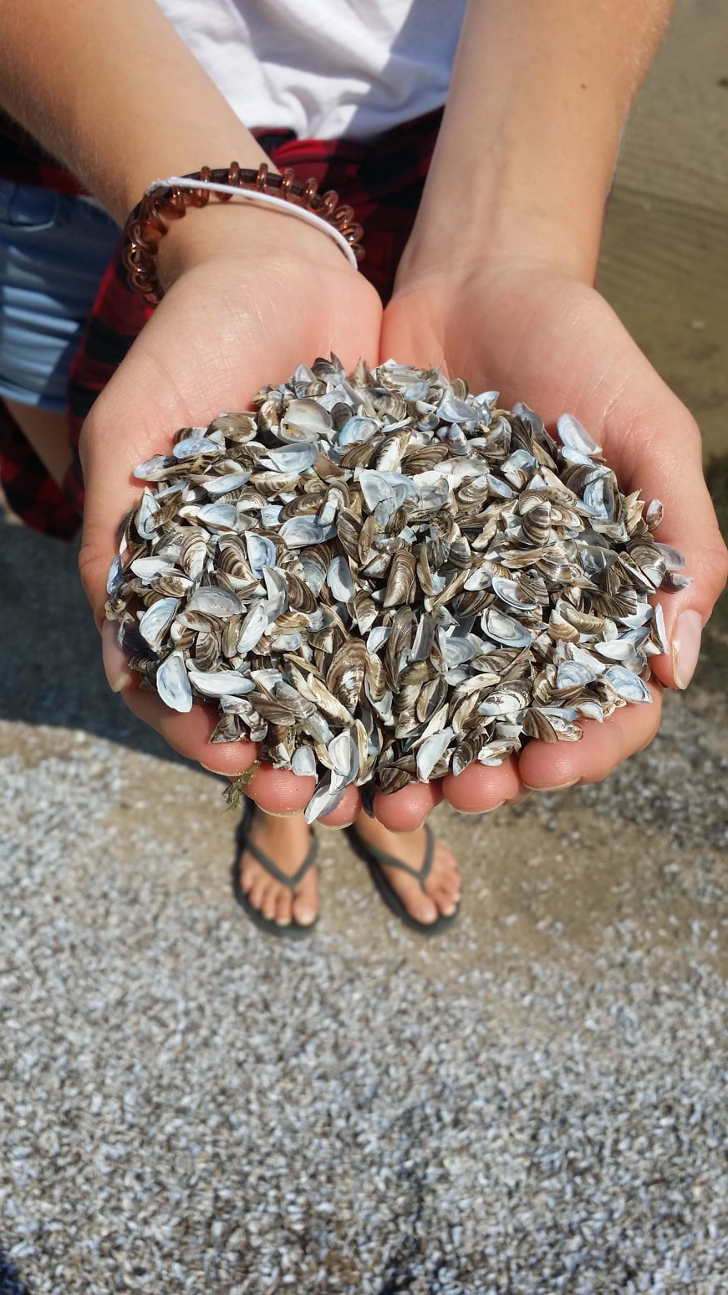
Lake Winnipeg Zebra Mussels

Slide 33
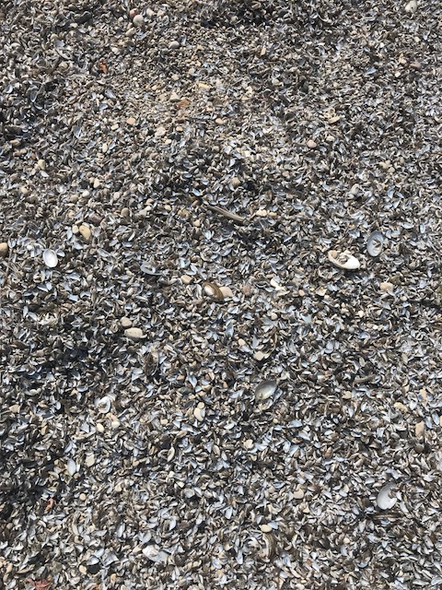
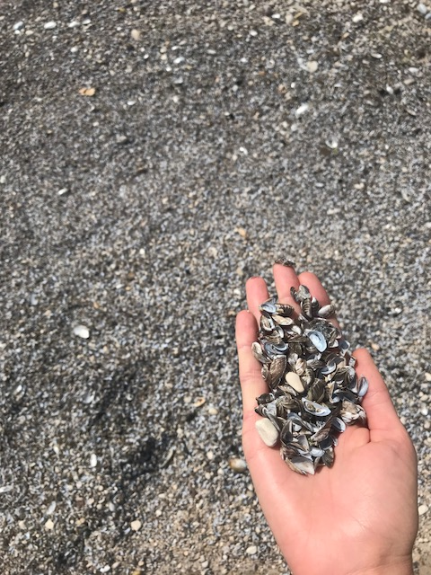

Slide 34
Questions?

